Slide 1



Slide 2
"Nothing in all creation is hidden from God's sight. Everything is uncovered and laid bare before the eyes of him to whom we must give account.“ Hebrews 4:13

Slide 4
"When we can let go of what other people think and own our own story, we gain access to our worthiness. The feeling that… we are worthy of love and belonging. (When we don't own our own story)… we hustle for our worthiness by constantly performing, perfecting, pleasing, and proving."
Brene Brown The Gifts of Imperfection

Slide 5
Point 1: God loves you

Slide 6
Bernard of Clairvaux The Four Degrees of Love
          Loving self for self’s sake
          Loving God for self’s sake
          Loving God for God’s sake
          Loving self for God’s sake

Slide 7
Don’t shrink. Don’t puff up. Stand on your sacred ground’.
Brene Brown

Slide 8
“The Divine indwelling is never earned by any behaviour, whatsoever or any ritual but it is only recognised and realised and fallen in love with”
Richard Rohr The Naked Now

Slide 9
Point 2: You are loved by God

Slide 10
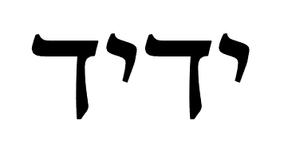

Slide 11
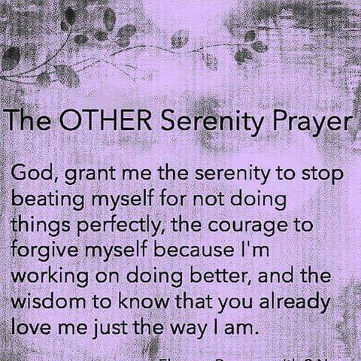
Relevant Image (unlike this one probably)

