Slide 1



Slide 2
Managing your Mind

Slide 3
1. Feelings

Slide 4


Slide 5
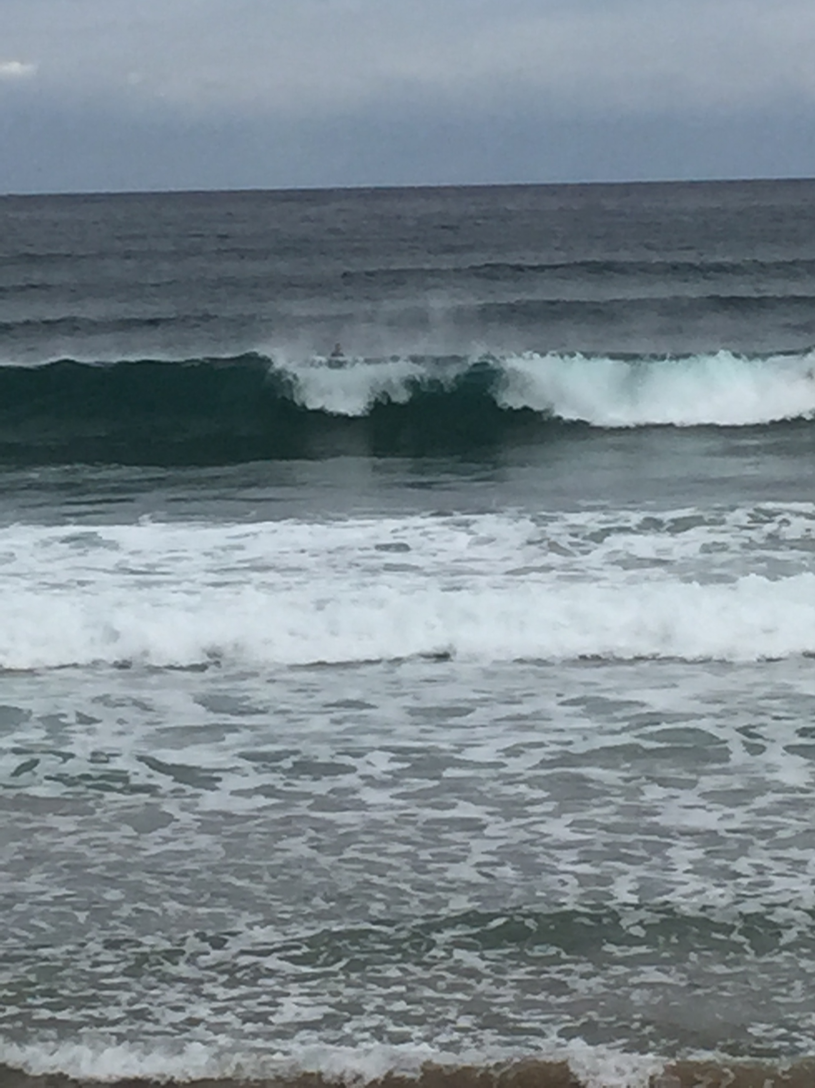

Slide 6
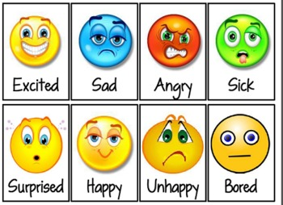

Slide 7

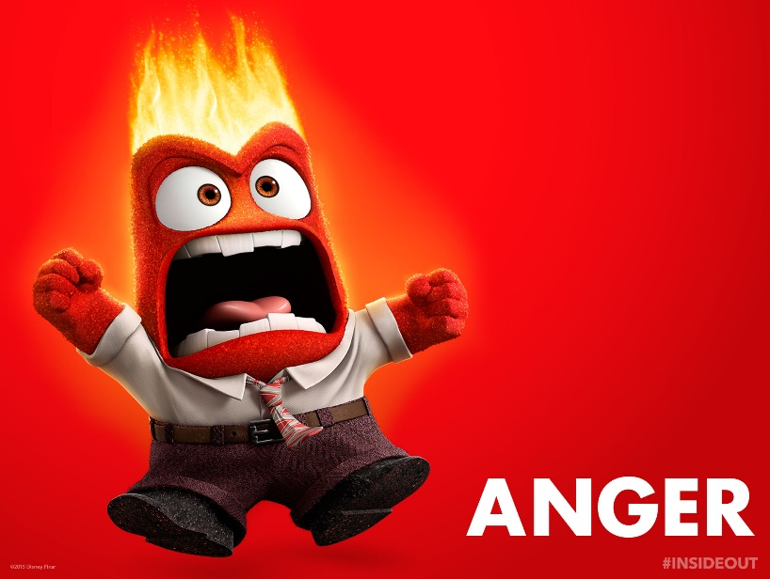
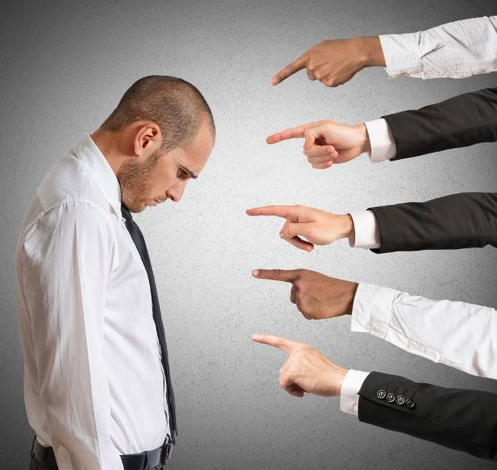
The BIG THREE ‘difficult’ emotions:
Anger
Shame/guilt
Anxiety

Slide 8
Managing Emotions
Own them
Share them
‘Weather’ them

Slide 9
1. Thoughts

Slide 10
If you don’t control them…
They will control you.

Slide 11
“ I think therefore I am”
Descartes
Was he right?

Slide 12
“ I BREATHE therefore I am” Sheila Bridge!

Slide 13
You are not your thoughts, your thoughts are just the story you are attaching to what is happening to you at the time.

Slide 14
Controlling Thoughts
Challenging wonky thinking
Be self-compassionate, catch yourself speaking mean to yourself
Practise stillness, meditation, quietening the mind

Slide 15
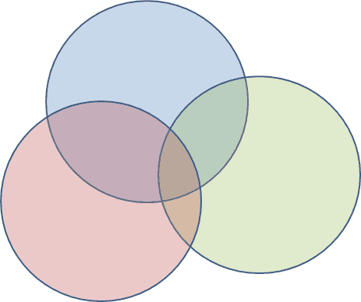

Slide 16


